Slide 1
Microbes in Water

Slide 2
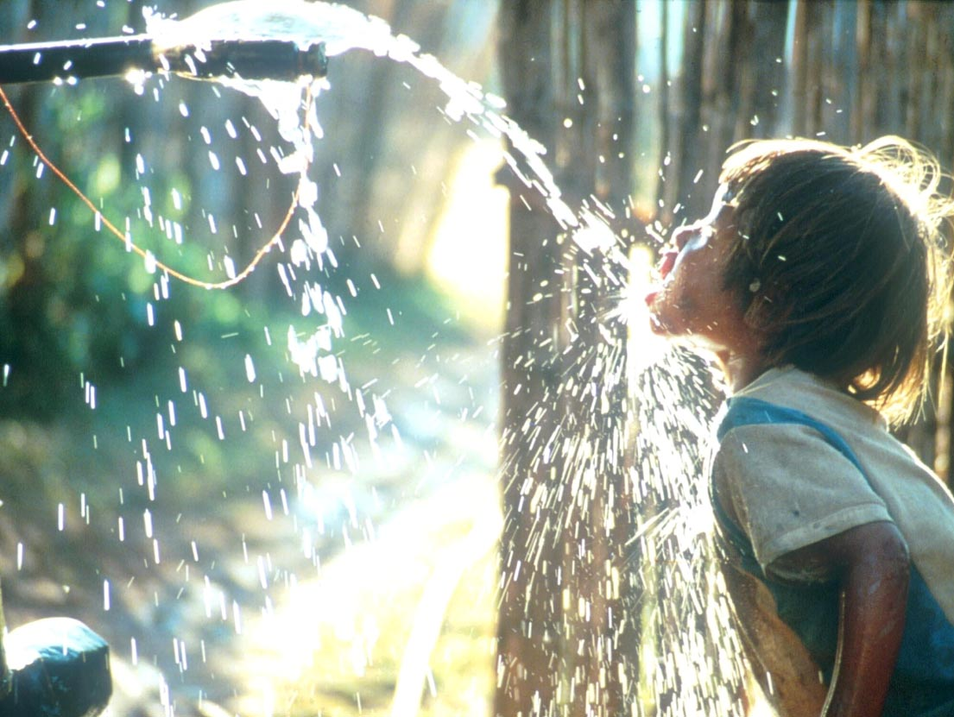

Slide 3
Drinking water: Water that is safe to consume and free of pathogenic organisms and chemical substances that are harmful to human health.

Slide 4
Obtained from
Rain water
Surface water (rivers and streams)
Stored water
Ground water( wells and springs- filters through successive layers of sand).
Sea water

Slide 5
Quality standards of drinking water
Physical: colour, clarity, taste,odour, amount of suspended solids
Chemical: pH, amount of dissolved solids, hardness, amount of nitrogenous matter
Biological: Bacteriological content, amount of dissolved oxygen (BOD)
Properties required for drinking water
Tasteless, colourless, cool, clear and free of pathogens.

Slide 6
Drinking water guidelines which are followed:
US public health service
World health organization (WHO)
Environmental protection agency (EPA).

Slide 7
Water pollution
Any physical or chemical change in water that adversely affects the health of the human and other organisms.

Slide 8
Water Pollution and Eutrophication
Pathogens
Organic wastes
Sediment
Chemical pollutants
Nutrients

Slide 9
Eutrophication: an enrichment problem
Lake, estuaries and slow flowing streams that have minimal levels of nutrients are unenriched called as an oligotrophic lake.
It has clear water and small populations of aquatic organisms.

Slide 10
Eutrophication is the enrichment of a lake, estuary or slow flowing stream by inorganic plant and algal nutrients.
The enrichment of water results in an increased photosynthetic productivity.
The water in a eutrophic lake is cloudy and usually has vast numbers of algae and cyanobacteria.

Slide 11
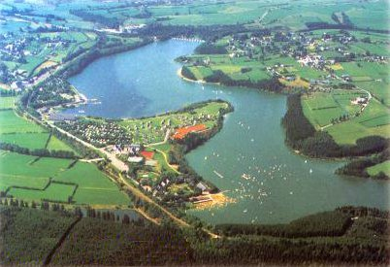

Slide 12
Pollution → effects man, flora and fauna
Addition of chemicals to water
Pesticide residues
Other toxic chemicals
Algal toxins
Fecal contamination (microbial)→ Water borne diseases
contaminated drinking water has become a major threat.

Slide 13
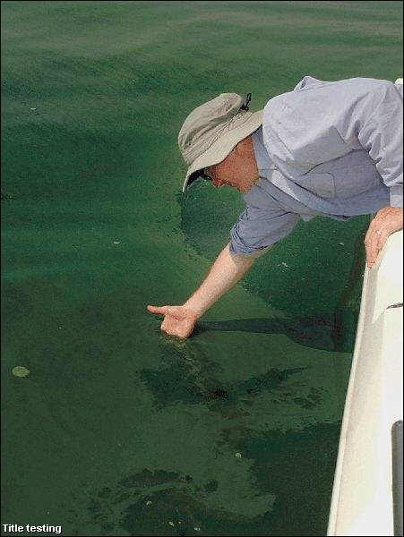
Blue-green algae bloom

Slide 14
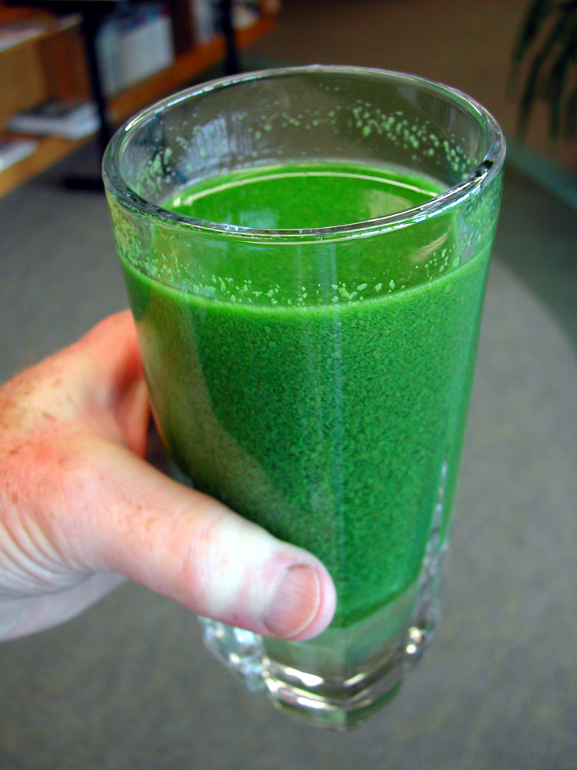
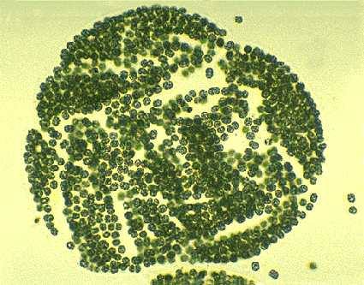
Microcystis
A toxic blue-green alga

Slide 15
Implications of Microbial Contamination of Water
potential for transmission of disease causing microorganisms (pathogens) via water contact - oral fecal route
contact includes ingestion, primary contact, and secondary contact

Slide 16
Water Borne Diseases/Pathogens
Bacteria
Vibrio cholera - cholera
Yersinia enterocolitica - gastroenteritis
Escherichia coli - gastroenteritis
Shigella sp.- gastroenteritis
Listeria monocytogenes - flu-like symptoms
Salmonella sp. - gastroenteritis, typhoid
Campylobacter jejuni - gastroenteritis (animals sources)

Slide 17
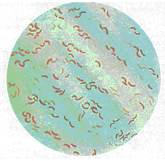
Vibrio cholerae

Slide 18
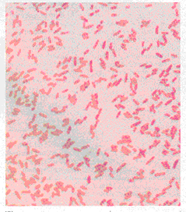
Yersinia enterocolitica

Slide 19
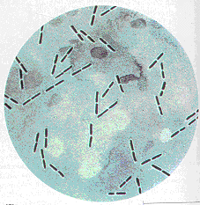
Clostridium perfringens

Slide 20
Water Borne Diseases/Pathogens
Viruses
Polio Virus - paralytic poliomyelitis
Rotaviruses - gastroenteritis
Norwalk Viruses - gastroenteritis
Hepatitis Type A and E - liver inflammation

Slide 21
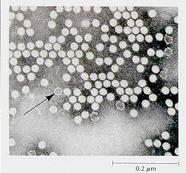
Polio Virus

Slide 22
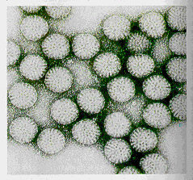
Rotavirus

Slide 23
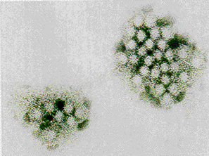
Norwalk Agent

Slide 24
Water Borne Diseases/Pathogens
Protozoa
Entamoeba histolytica - amoebic dysentery
Giardia lamblia - intestinal disease
Cryptosporidium sp. - intestinal disease

Slide 25
Water we drink has to be purified
purification of water
Tap water
boiling
Eliminate most pathogens

Slide 26
How we detect contamination?
Heterotrophic plate count (HPC)
Indicator of overall sanitation in water
HPC limits
100-500cfu/ml in tap water
50cfu/ml in bottled water (WHO, 2001).
HPC bacteria present in water samples can be determined by the pour plat method on nutrient agar, and incubated at 37C for 48 hours.

Slide 27
Difficulties With Routine Testing of Pathogens in Water
present in low numbers
limited survival time
numerous pathogens to analyze
time and cost prohibitive

Slide 28
Testing of Indicator Organisms
need an indicator of potential pathogen contamination of water which is easy, reliable, inexpensive, quick, etc.

Slide 29
Requirements of Indicator Organisms
present when pathogens present in water
absent in uncontaminated water
present in higher numbers than pathogens in contaminated water
quantity of the organism should correlate with the amount of pollution.
survives better and longer than to that of the pathogen.
generally harmless to humans and other animals
easy to analyze

Slide 30
Coliform Bacteria and Drinking Water
Public water systems are required to deliver safe and reliable drinking water to their customers 24 hours
a day, 365 days a year. If the water supply becomes contaminated, consumers can become seriously ill.
Fortunately, many steps are being taken to ensure that the public is provided with safe drinking water.
One of the most important steps is to have the water tested for coliform bacteria. Public water systems
must test for coliform bacteria regularly.

Slide 31
What are coliform bacteria?
Coliform bacteria are organisms that are present in the environment and in the feces of all warm-blooded animals and humans.
Coliform bacteria will not likely cause illness. However, the presence of coliform bacteria in drinking water indicates that disease-causing organisms (pathogens) may be present in the water system. Most pathogens that can contaminate water supplies come from the feces of humans or animals.

Slide 32
Testing drinking water for all possible pathogens is complex, time-consuming, and expensive.
It is relatively easy and inexpensive to test for coliform bacteria. If coliform bacteria are found in a water sample, steps are taken to find the source of contamination and restore safe drinking water.
There are three different groups of coliform bacteria; each has a different level of risk.

Slide 33
Total coliform, fecal coliform, and Escherichia coli
Total coliform, fecal coliform, and E. coli are all indicators of drinking water quality. The total coliform group is a large collection of different kinds of bacteria. The fecal coliform group is a sub-group of total coliform and has fewer kinds of bacteria. E. coli is a sub-group of fecal coliform.

Slide 34


Slide 35
When a water sample is sent to a lab, it is tested for total coliform. If total coliform is present, the sample will also be tested for either fecal coliform or E. coli, depending on the lab testing method.

Slide 36
Total coliform bacteria
Are commonly found in the environment (e.g., soil or vegetation) and are generally harmless. If only total coliform bacteria are detected in drinking water, the source is probably environmental. Fecal contamination is not likely.
However, if environmental contamination can enter the system, there may be a way for pathogens to enter the system. Therefore, it is important to determine the source and to resolve the problem.

Slide 37
Fecal coliform bacteria
A sub-group of the total coliform group. They appear in great quantities in the intestines and feces of people and animals. The presence of fecal coliform in a drinking water sample often indicates recent fecal contamination – meaning that there is a greater risk that pathogens are present than if only total coliform bacteria is detected.

Slide 38
E. coli is a sub-group of the fecal coliform group. Most E. coli are harmless and are found in great quantities in the intestines of people and warm-blooded animals. Some strains, however, may cause illness.

Slide 39
The presence of E. coli in a drinking water sample almost always indicates recent fecal contamination – meaning that there is a greater risk that pathogens are present.
WHO bacteriological quality of drinking water (WHO, 1996)
E.coli or thermotolerant coliform bacteria -Must not be detectable in any 100ml sample
Total coliform bacteria -Must not be detectable in any 100ml sample

Slide 40
A Note about E. coli:
Most outbreaks have been related to food contamination, caused by a specific strain of E. coli known as E. coli O157:H7. When a drinking water sample is reported as “E. coli present” it does not mean that this specific strain is present and in fact, it is probably not present. However, it does indicate recent fecal contamination.
Boiling, or treating contaminated drinking water with a disinfectant, destroys all forms of E. coli, including O157:H7.

Slide 41
Coliform Bacteria - Indicators of Fecal Contamination
bacteria in the family Enterobacteriaceae
generally include the genera Enterobacter, Klebsiella, Citrobacter, and Escherichia and Aeromonas sp.
present in the intestinal tract of numerous organisms
gram negative, non-spore forming rods
ferment lactose with acid and gas production in 48 hours at 35 °C

Slide 42
Family -ENTEROBACTERIACEAE
Coliforms
Total coliforms- Escherichia sp. Enterobacter sp., Citrobacter sp., Klebsilla sp., Serratia sp., Yersinia sp.
Fecal coliforms – Escherichia coli,
Non Coliforms – Salmonella sp. Shigella sp. Proteus sp. Erwinia sp. Hafnia sp.

